Slide 1

Binary numbers
TECHNOLOGY
0011111010011010100010000111100000001001010111001001001000000100101000101101001111000111110010101001
© State of NSW, Department of Education, 2017
Copyright
Notes:
Teacher’s notes
You may wist to print a ‘Notes Pages’ version of this presentation before using it with your class in order to have access to these Teacher’s notes. Alternatively, tick the ‘Use Presenter View’ option when showing the presentation to your class.

Slide 2
Computers are called digital devices because
QUESTION 1
they store data as binary digits
Correct
we manipulate them with our fingers
Try again
Click on an answer to test if you are correct.
Notes:
Teacher’s notes
Discuss the reason why computers are called ‘digital devices’ with the class.
Clicking on the 2 possible answers will reveal if the answer is correct or incorrect.

Slide 3
A binary digit can be
QUESTION 2
a number 1 or 0 only
Correct
a single digit between 0 and 9
Try again
Stored as a tiny current being on or off
Correct
Click on an answer to test if you are correct.
Notes:
Teacher’s notes
Discuss the definition of a ‘binary digit’ with the class.
Clicking on the 3 possible answers will reveal if the answer is correct or incorrect.

Slide 4

Using binary has the advantage that it has built in accuracy.
It is either OFF
0
or ON
1
Click here to find out more
Computers are usually built from cheap, inaccurate components.
Binary systems can just use ‘on’ or ‘off’ – you don’t have to be precise.
A system that uses more numbers (such as 0-9) has to be able to indicate how big a number is, not just if it is there at all.
Notes:
Teacher’s notes
Discuss with the class how binary is used to improve the accuracy of computers.
Clicking ‘Click here to find out more’ reveals more information on the topic.

Slide 5
Instructions
Calculate value of power of 2
Click the grey boxes to see the decimal values.
Power of 2 | 2⁷ | 2⁶ | 2⁵ | 2⁴ | 2³ | 2² | 2¹ | 2⁰
Decimal value | 128 | 64 | 32 | 16 | 8 | 4 | 2 | 1
Try it yourself
Convert the following binary number to decimal.
Binary digits | 0 | 1 | 1 | 0 | 0 | 1 | 0 | 1
Decimal value
The number is 0 + 64 + 32 + 0 + 0 + 4 + 0 + 1 = 101
Binary 01100101 = decimal 101
Check your answer
Notes:
Teacher’s notes
Students can use a calculator to find the value of 2 to various powers.
Click the grey boxes to reveal the answer to each exponential.
During the presentation, it is possible to click in the white boxes in the second table and type answers. Each time there is a number 1 in the byte (0110 0101) enter the decimal value from the first table.
Click ‘Check your answer’ to see the solution.
Click ‘Instructions’ to open a slide with detailed instructions and examples.

Slide 6
Practice by converting the following binary numbers to decimal
Power of 2 | 2⁷ | 2⁶ | 2⁵ | 2⁴ | 2³ | 2² | 2¹ | 2⁰
Decimal value | 128 | 64 | 32 | 16 | 8 | 4 | 2 | 1
#1 | 1 | 0 | 1 | 0 | 1 | 0 | 0 | 0
#2 | 0 | 0 | 0 | 1 | 1 | 1 | 0 | 1
#3 | 1 | 1 | 0 | 0 | 0 | 0 | 0 | 1
Answers
1.
2.
3.
168
Check your answer
29
Check your answer
193
Check your answer
Notes:
Teacher’s notes
Students will practice the process by converting 3 more binary numbers into their decimal equivalent.
During the presentation, it is possible to click in the white boxes under the table and type answers.
Clicking any of the ‘Check your answer’ buttons will reveal the correct answer.

Slide 7
Instructions
Convert 55 from a decimal number to a binary number.
Click the grey boxes to reveal the working out.
Power of 2 | 2⁷ | 2⁶ | 2⁵ | 2⁴ | 2³ | 2² | 2¹ | 2⁰
Decimal value | 128 | 64 | 32 | 16 | 8 | 4 | 2 | 1
Working it out | 55 has no lots of 128 | 55 has no lots of 64 | 55 has one lot of 32 23 left over | 23 has one lot of 16 7 left over | 7 has no lots of 8 | 7 has one lot of 4 3 left over | 3 has one lot of 2 1 left over | 1 has one lot of 1
Binary value
The binary number is 0011 0111
Check your answer
Notes:
Teacher’s notes
Students will attempt to convert the decimal number 55 into a binary number.
Click the grey boxes to reveal the step-by-step process.
During the presentation, it is possible to click in the white boxes in the last row and type answers.
Click ‘Check your answer’ to see the solution.
Click ‘Instructions’ to open a slide with detailed instructions and examples.

Slide 8
Practice by converting the following binary numbers to decimal
Power of 2 | 2⁷ | 2⁶ | 2⁵ | 2⁴ | 2³ | 2² | 2¹ | 2⁰
Decimal value | 128 | 64 | 32 | 16 | 8 | 4 | 2 | 1
129
51
17
Answers
1.
2.
3.
1000 0001
Check your answer
0011 0011
Check your answer
0001 0001
Check your answer
Notes:
Teacher’s notes
Students will practice the process by converting 3 more decimal numbers into their binary equivalent.
During the presentation, it is possible to click in the white boxes under the table and type answers.
Clicking any of the ‘Check your answer’ buttons will reveal the correct answer.

Slide 9
Additional resources
The following website provide more information to help you understand binary numbers:
http://csunplugged.org/binary-numbers/
http://www.mathsisfun.com/binary-number-system.html
Notes:
Teacher’s notes
To extend this activity or to provide more support/understanding, please consider the sites listed in the slide.

Slide 10
The end
There are 10 types of people in this world;
those who understand binary
and those who don't.
Notes:
Teacher’s notes
As a class, discuss this statement/joke.
If you get stuck, try converting the binary number 10 into a decimal number.

Slide 11
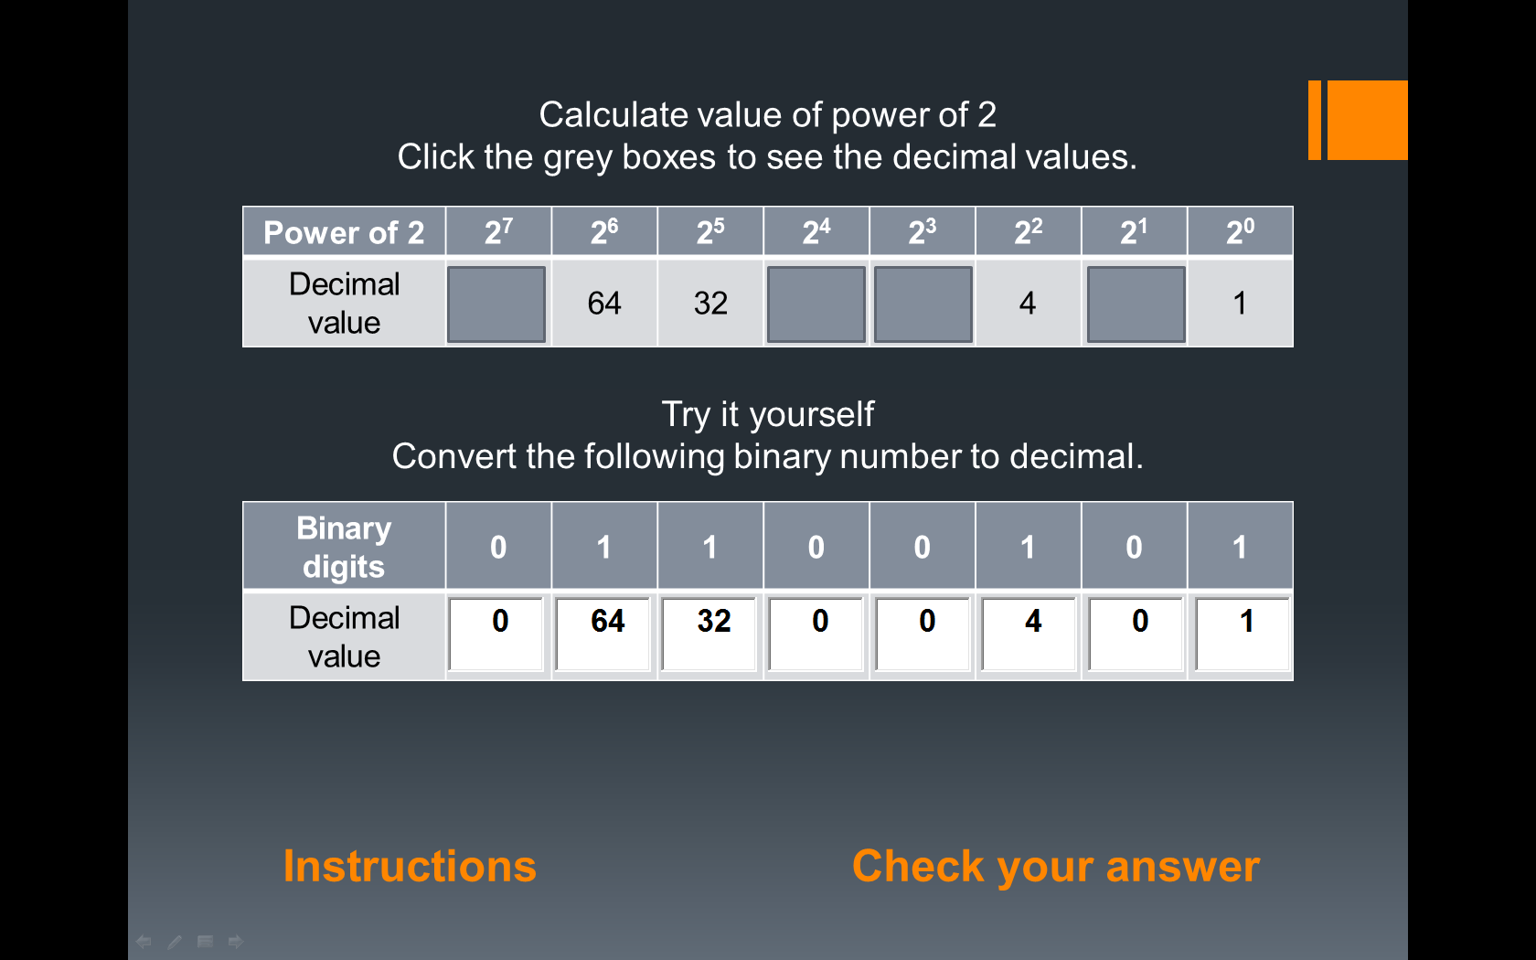
Instructions: Convert binary to decimal
Click the grey squares to reveal the value of 2 to the various powers
For each binary number 1, record the decimal value from the top table (remember 0 is off and has no value)
Add the decimal values together (e.g. 64 + 32 + 4 + 1)
Back
Notes:
Teacher’s notes
Please use the ‘Back’ button to navigate back to the presentation.

Slide 12
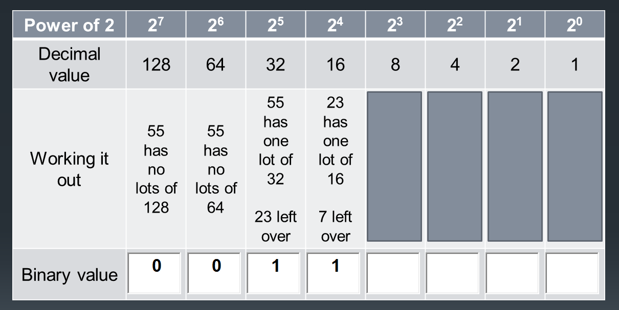
Instructions: Convert decimal to binary
Click the grey squares to reveal the working out process
For each decimal value that is present, record a 1 in the binary row, otherwise record a 0
Back
Notes:
Teacher’s notes
Please use the ‘Back’ button to navigate back to the presentation.

Slide 13
Copyright
© State of New South Wales (Department of Education), 2017.
The New South Wales Department of Education supports and encourages the dissemination and exchange of publicly funded information and endorses the use of the Australian Governments Open Access and Licensing Framework (AusGOAL).
The copyright material published in this resource is subject to the Copyright Act 1968 (Cth), and is owned by the New South Wales Department of Education or, where indicated, by a party other than the New South Wales Department of Education (third party material).
Copyright material available in this resource and owned by the New South Wales Department of Education, is licensed under a Creative Commons Attribution 4.0 International (CC BY 4.0) licence.
This licence allows you to:
Share – copy and redistribute the material in any medium or format
Adapt – remix, transform, and build upon the material for any purpose, even commercially.
Attribution should be given to © State of New South Wales (Department of Education) 2017.
Material in this resource not available under a Creative Commons licence:
The New South Wales Department of Education logo, other logos and trade mark protected material
Material owned by a third party that has been reproduced with permission. Permission will need to be obtained from the third party to re-use its material.
Linked material available on third party websites
If you use the links provided in this resource to access a third party's website, you acknowledge that the terms of use, including licence terms set out on the third party's website apply to the use which may be made of the materials on that third party's website or where permitted by the Copyright Act 1968 (Cth).
If this resource contains links to your website and you have any objection to such links, please contact the Department of Education at: legal@det.nsw.edu.au
Further Information
For further information about the copyright in this resource, please email: legal@det.nsw.edu.au
Back
Notes:
Teacher’s notes
Please use the ‘Back’ button to navigate back to the presentation.

